Slide 1
Washington Craft Beer Portal
The purpose of the Northwest Craft Beer app is to help the thirsty find the location of craft breweries in Washington State. Users are able to find a brewery either by name or by city. The Beer Mapping API will provide a JSON file from which information about the breweries can be obtained.
NAVIGATION: There will be an initial page showing up to ten breweries, with Next and Previous buttons to advance to the next set of entries or revert to the previous set of entries. One may then click on the link for a particular brewery. The information for the selected brewery will appear, and a Back and Display Map button. The Back button will return the user to the list of breweries. The Display Map button will cause a map of the brewery location to appear on the page.

Slide 2

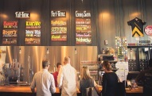



Washington Craft Beer Portal
Image
Georgetown Brewing Company
Brewery
Name
Previous
Next
Credits

Slide 3

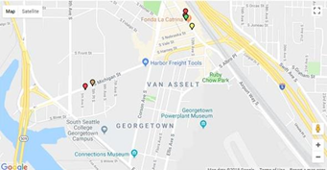

Washington Craft Beer Portal
Georgetown Brewing Company
Type: Beer Bar
Address: 5840 Airport Way S, #201
City: Seattle, WA 98108
Phone: (206) 766-8085
Website: georgetownbeer.com
Rating: 4.5
Latitude: 47.55032,
Longitude: -122.31803
Back
Display Map

Slide 4

Credits
Dependencies: react-routing
react-rating
BeerMappingAPI (https://beermapping.com/api/)
Authors: Don Sando and Craig McMahan
Date: June 25, 2018

